Slide 1


Founder’s Message
Dear Brothers, Sisters and Friends
Divya Life Nutritions is medically and scientifically proven concept for healthcare and wellness. Our services and products are specially designed for disease management, disease prevention and wellness.
For disease management we serve for all types lifestyle disorders, and in prevention we serve for creating deep relaxation, accelerates bodies self healing capacity and ability, releases stress and tension, aids better sleep, breaks addiction, removes energy blockages, bringing body into balance and harmony
Into wellness category we serve for supports the immune system, increase vitality and postpones the aging process, keep body into shape and beautiful, exfoliate dead skin cells, eliminate toxins and increase blood circulation, boosting moisture in the skin, re-mineralize the skin and body etc.
Dr Dilipkumar Yadav

Slide 2
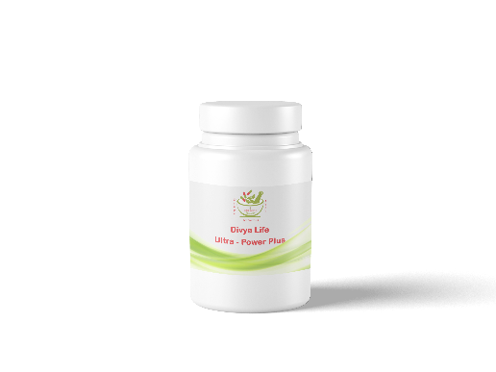
DIVYA LIFE
ULTRA-POWER PLUS
Health Benefits
Increasing testosterone levels
Maintain sperm count
Enhance sex drive naturally
Blood flow increaser
Good for increasing sexual stamina
Good for feeling sexual desire
Boosts energy and sex drive
NUTRITION FACT
Ginseng 500 mg
Ashwgandha 300 mg
Mucuna Puritis 200 mg

Slide 3
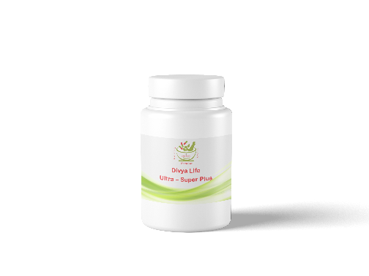
DIVYA LIFE ULTRA-SUPER PLUS
PRODUCT IMAGE
HEALTH BENEFITS
Helps for conversion of hormones into estrogen and testosterone
Contributes into resolving erectile challenges
Maintaining an erection firm enough to have sexual intercourse
Increasing the body's ability to achieve and maintain an erection during sexual stimulation
Nutritional Fact
Horney Goat Weed 500mg
Gingko Biloba 300mg
Yohimbine 200mg

Slide 4

DIVYA LIFE ULTRA-MEN’S PLUS
PRODUCT IMAGE
HEALTH BENEFITS
Increasing sperm concentrations, serum testosterone levels, sperm motility and enhance volume of ejaculation
Proven to raise levels of testosterone which result in an increased sex drive
Increase libido, testosterone, contribute into process of libido and firmer erections
Nutritional Fact
Maca Root Extract 250 mg
Tongkat Ali Root Extract 250 mg
Mucuna Puritis 250 mg
Saw Palmeto Berry 250 mg

Slide 5

DIVYA LIFE ULTRA-WOMEN’S PLUS
PRODUCT IMAGE
HEALTH BENEFITS
Improving fertility, sexual desire, act as a anti-depressant and also enhance energy and quality of life
Helpful into many aspects of sexual dysfunction, including desire and lubrication
Helpful for improving libido, energy and orgasm in women
Promoting sexual arousal in women by improving blood flow to the sex organs
NUTRITIONAL FACT
Maca (Lepidium Meyenii) 300 mg
Red Clover (Trifolium Pratense) 150 mg
Korean Red Ginseng 300 mg
Tribulus (Tribulus Terrestris) 150 mg

Slide 6
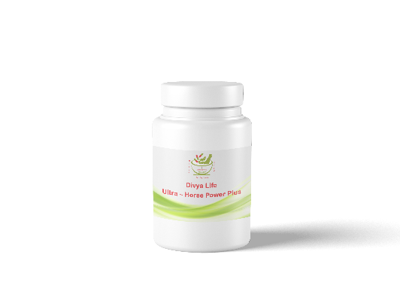
DIVYA LIFE ULTRA-HORSE POWER PLUS
HEALTH BENEFITS
Increasing testosterone levels maintain sperm count and enhance sex drive naturally
Blood flow increaser act as an important for good sexual stamina and good sexual desire, Boosts energy and sex drive
Increases blood flow, increases testosterone, contributes into resolving erectile challenges
PRODUCT IMAGE
Nutritional Fact
L – Arginine 250 mg
L – Citruline 100 mg
L – Ornitine 50 mg
Selenium 100 mcg
Testosterone 40 mg

